Slide 1


Slide 2
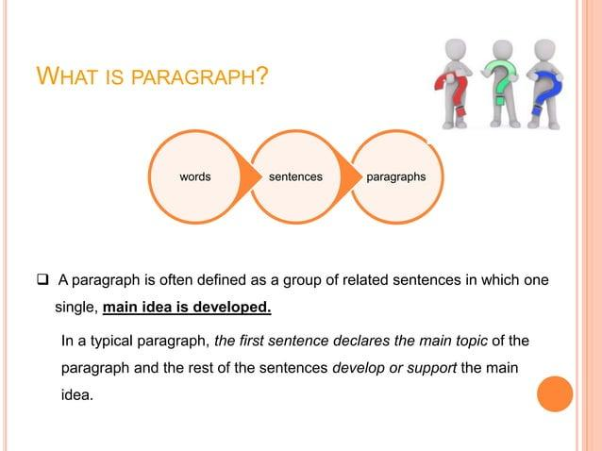

Slide 3
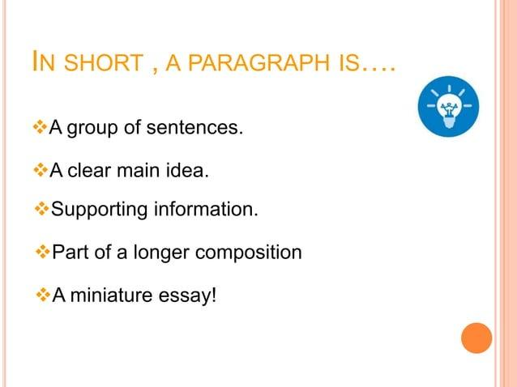

Slide 4
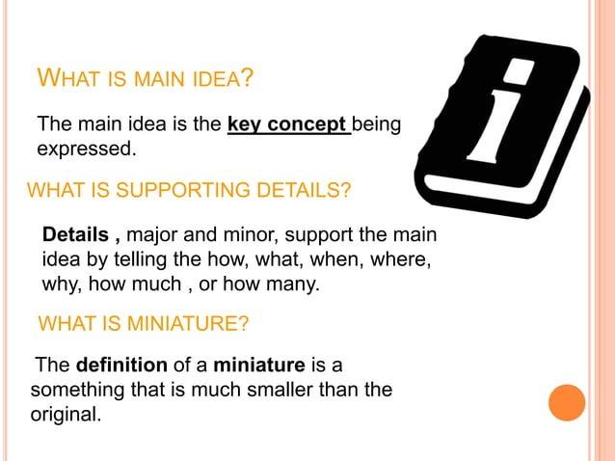

Slide 5
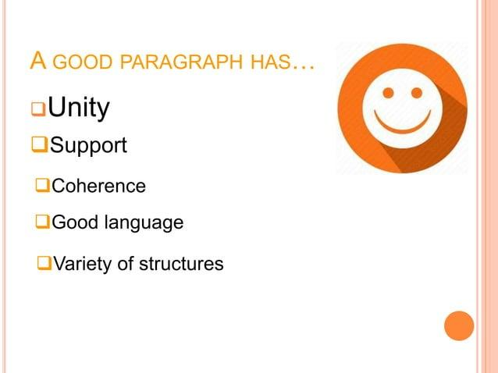

Slide 6


Slide 7
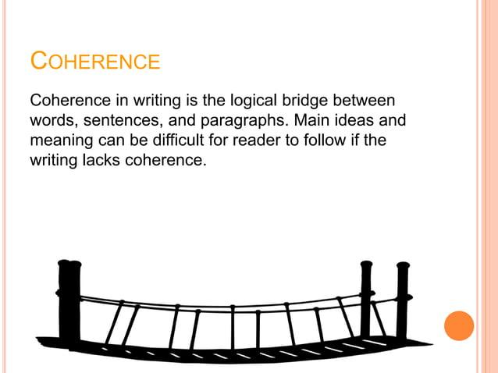

Slide 8
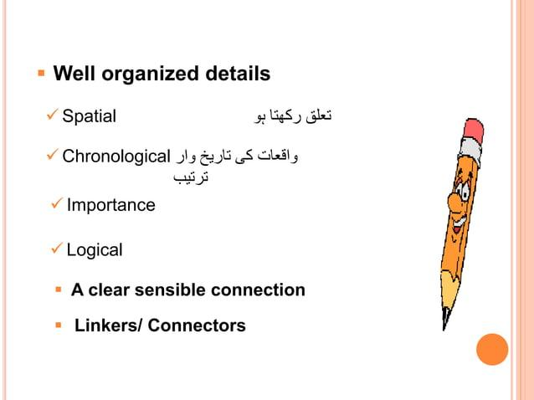

Slide 9
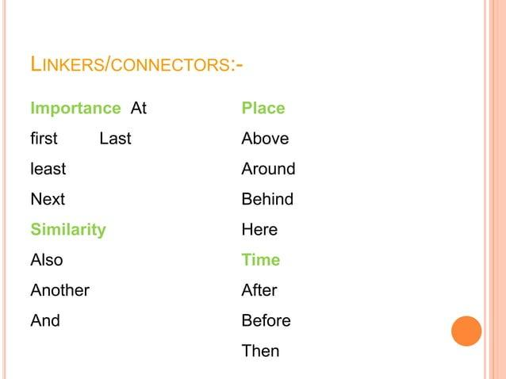

Slide 10
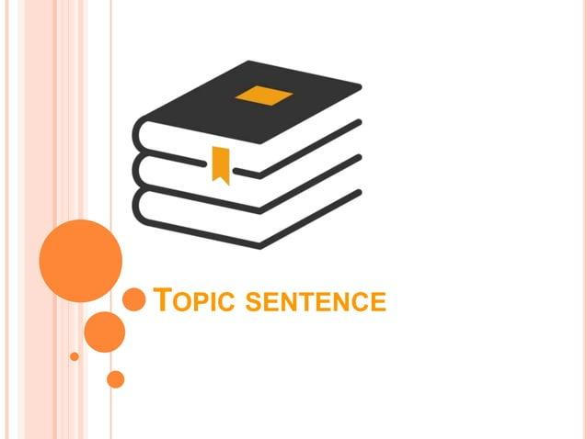

Slide 11
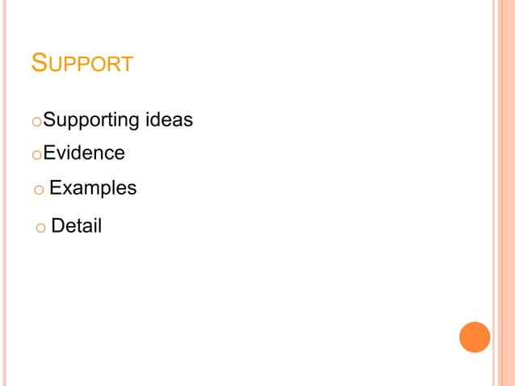

Slide 12
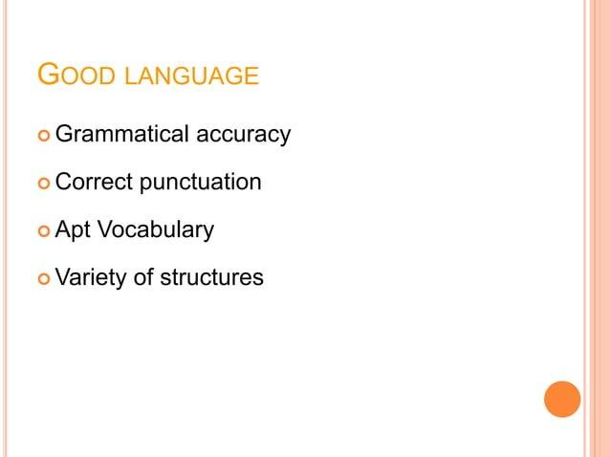

Slide 13
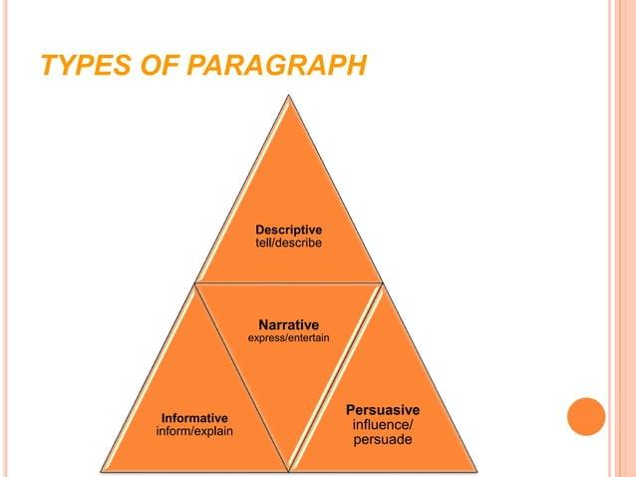

Slide 14
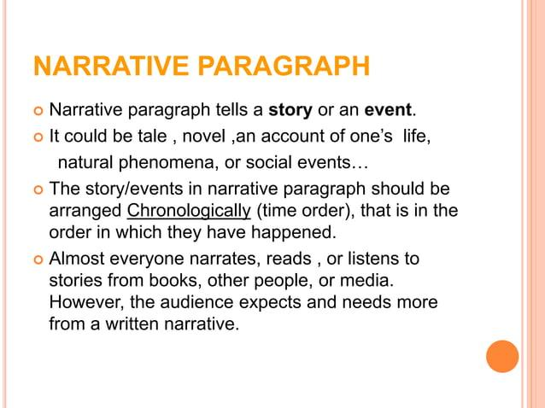

Slide 15
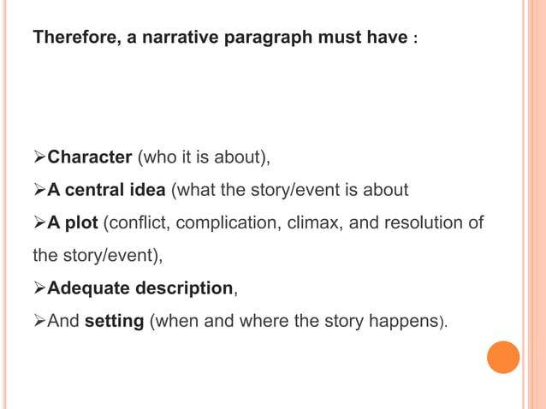

Slide 16
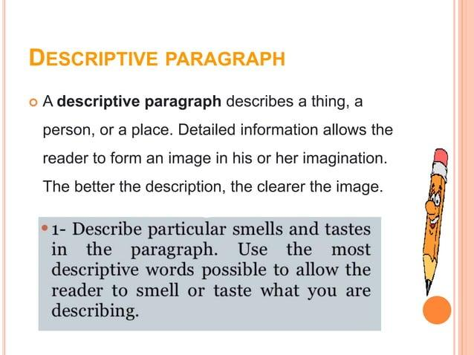

Slide 17
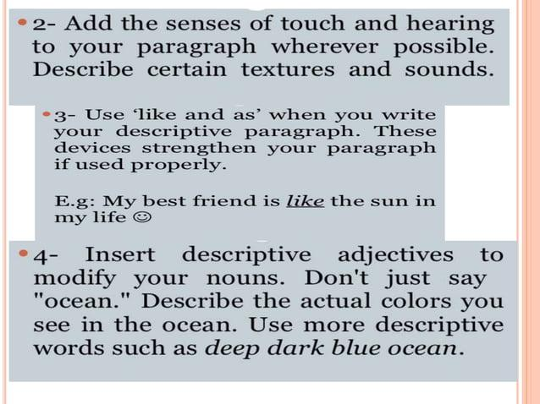

Slide 18
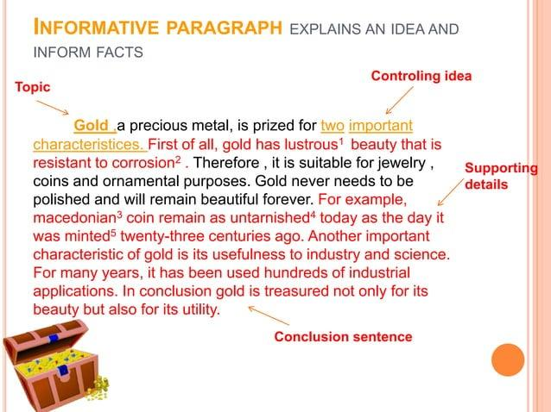

Slide 19
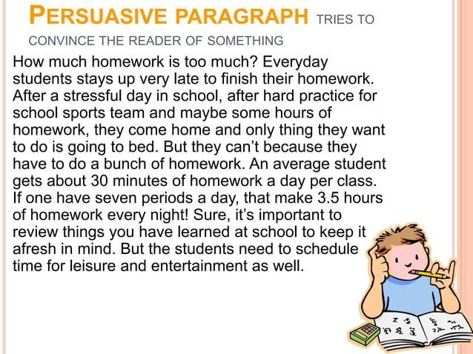

Slide 20
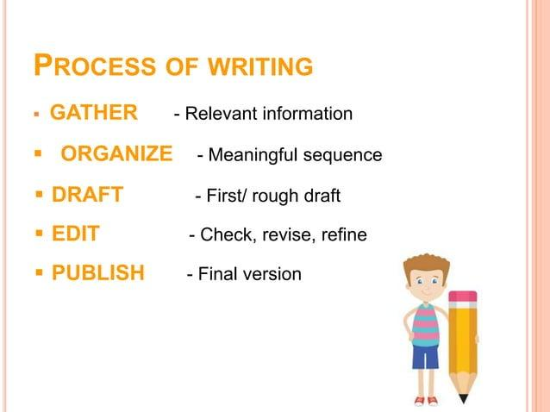

Slide 21
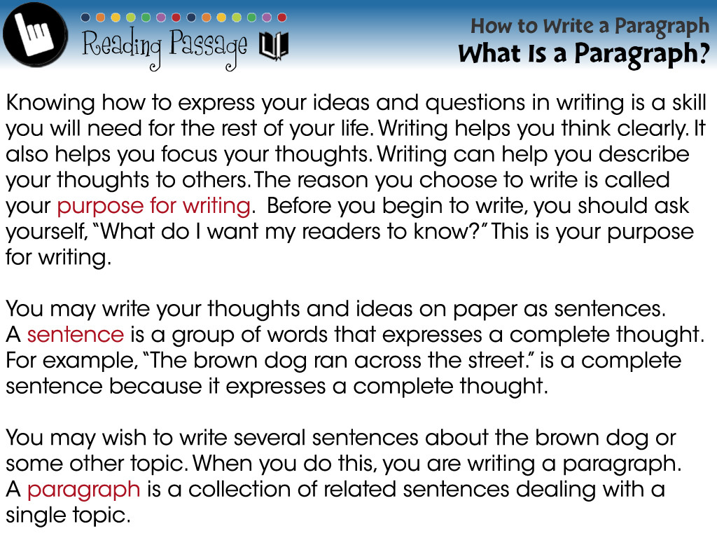

Slide 22

The topic sentence
The topic of a paragraph is often introduced by a key sentence. This is usually called the ‘topic sentence’ and generally contains the main idea of the paragraph.

Slide 23
Supporting sentences
Provide more details and general information about the topic sentence.

Slide 24
Ending sentence
This closes the paragraph. An ending sentence may repeat the topic in a different way, or express what we think or how we feel about the topic.

Slide 25
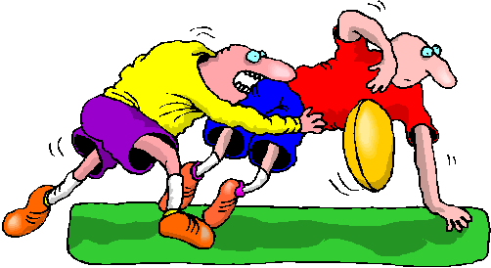
Example:
The sport of rugby league teaches self-discipline. This is shown by the players being penalised for losing their temper or arguing with the referee. Learning self-control is an excellent thing for any sportsman.
Topic sentence
Supporting sentence
Ending sentence

Slide 26

Example:
Topic sentence
I enjoy going to college for so many reasons. You get to meet new people and make friends. I find the subject I’m studying quite challenging, but interesting. I really enjoy it!
Supporting sentences
End sentence

Slide 27
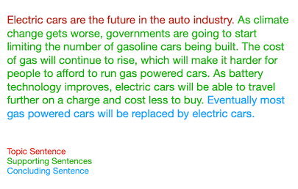

Slide 28
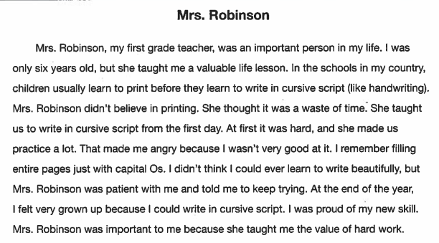

Slide 29


Slide 30
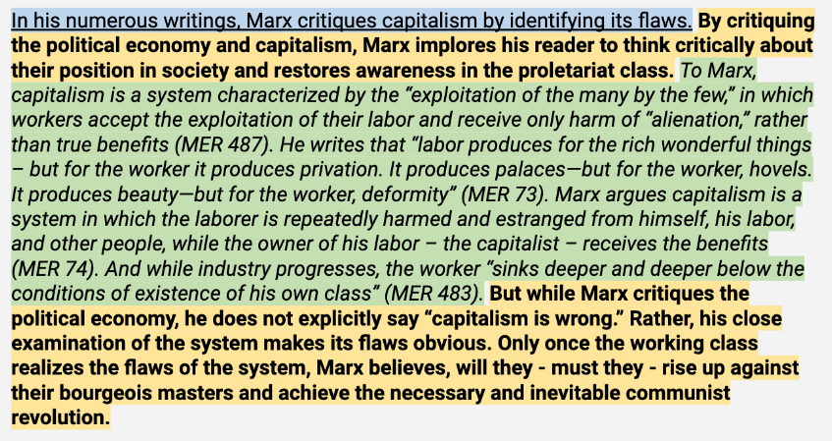

Slide 31


